Slide 1

Be Obedient
1 John
Dr. Rick Griffith • Crossroads International Church Singapore
BibleStudyDownloads.org

Slide 2
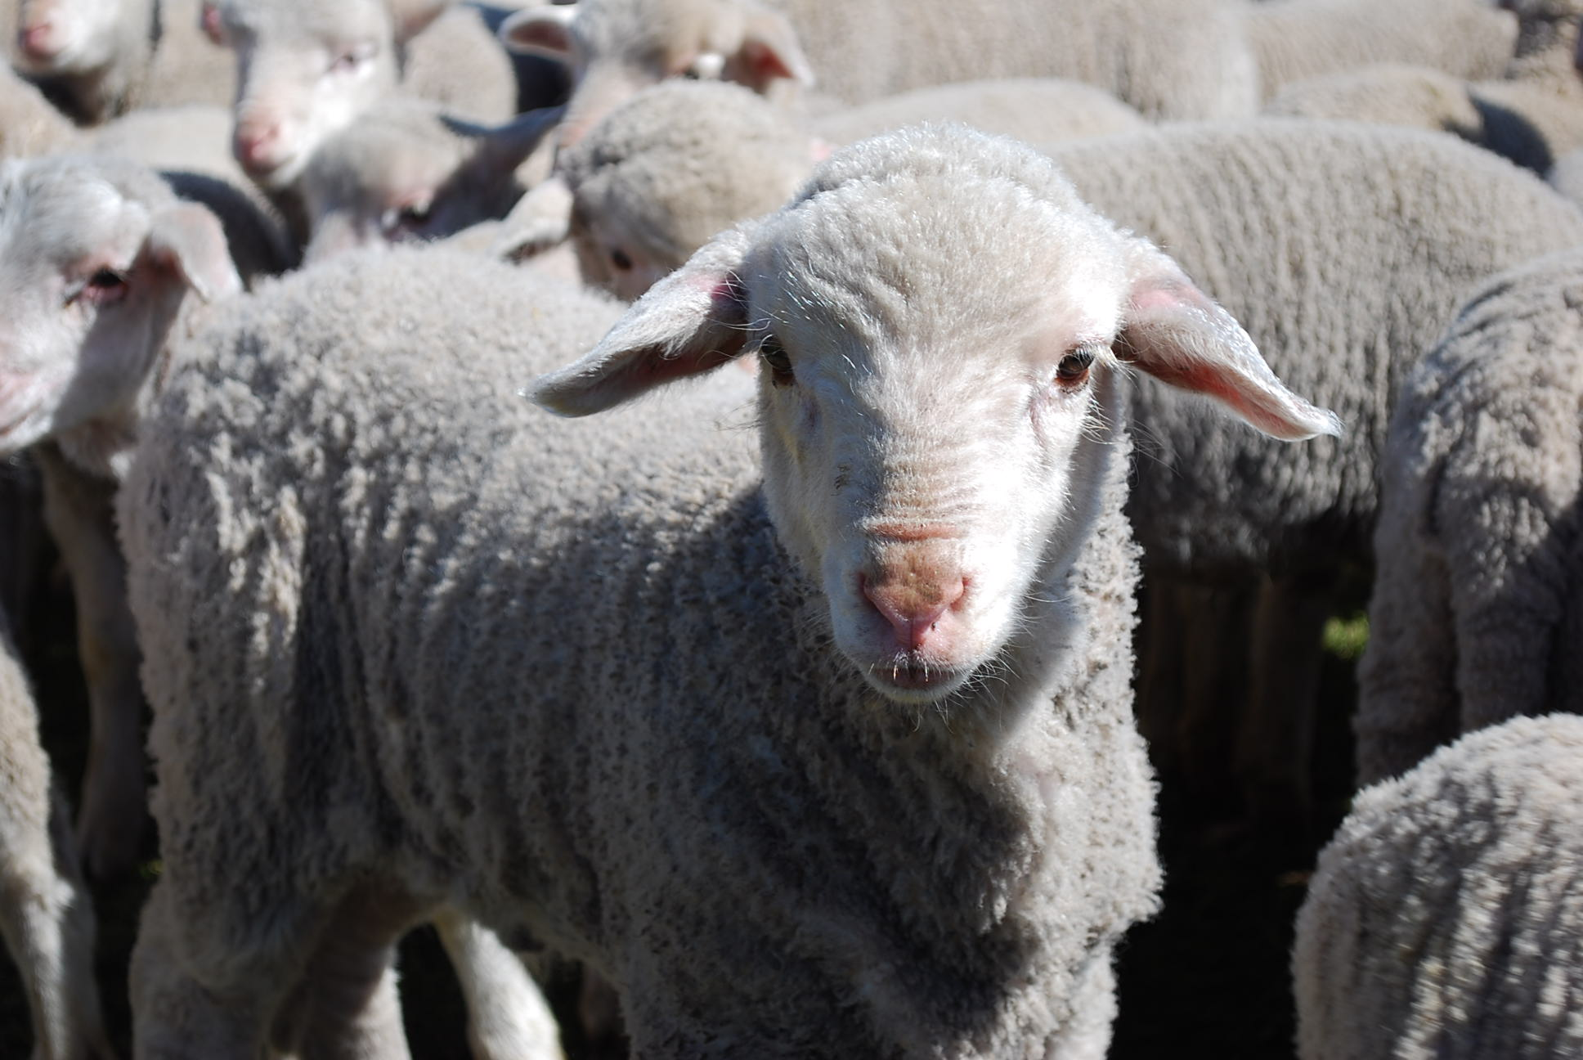
We are sheep.
Notes:
The animal that the Bible compares us to most is the sheep. Why do you think that is so?

Slide 3
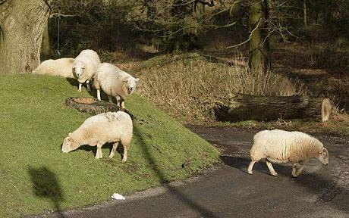
Sheep tend to stray.
Notes:
It’s because sheep easily lose their way—like us!

Slide 4
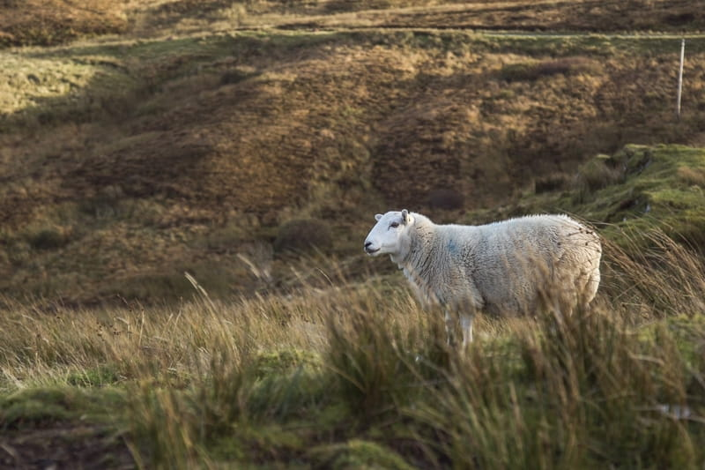
Lost sheep get lonely.
Notes:
Sheep are relational animals, so being away from the flock is lonely.

Slide 5
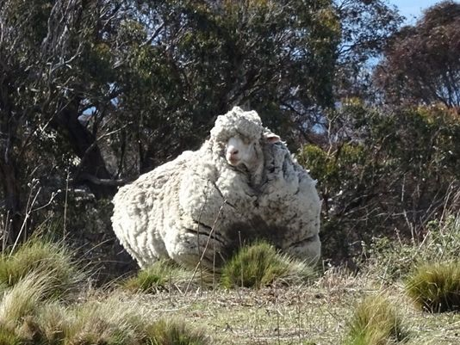
Sheep tend to return.
Notes:
Here is one sheep named Chris who was lost in Australia. He was found in 2015 by bush walkers after about 6 years of wandering. As you can see from the heavy coat of 90 pounds…

Slide 6
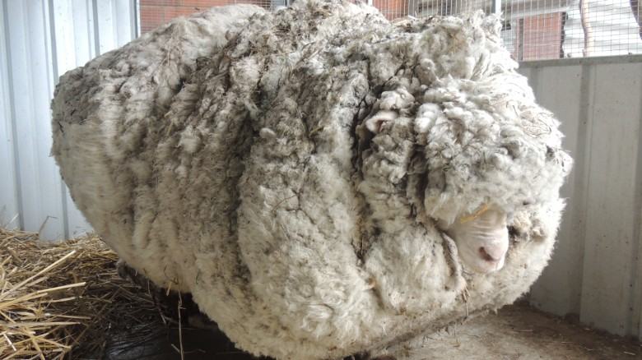
But straying has a price.
Notes:
The baggage from being away is quite a burden—for sheep as well as for people!
————————
Chris, the famously woolly sheep, has died
By Elizabeth Wolfe and Saeed Ahmed, CNN
Updated 1623 GMT (0023 HKT) October 22, 2019
Chris the sheep died in his home at the Little Oak Sanctuary.
(CNN)Chris the sheep lived a, shall we say, full and fluffy life, beloved by fans worldwide for his singular woolliness.
He died at his home at the Little Oak Sanctuary, where he had been living since his rise to fame in 2015.
While Chris should be appreciated for his many lovable qualities -- consider his kind eyes and gently sloping nose -- he became internationally celebrated after becoming the unofficial world record holder for having grown the heaviest fleece.
He was found outside of Australia's capital, Canberra, so overgrown with fleece that he could barely walk. Almost 90 lbs!
When he was found, Chris was carrying years worth of wool on his body, making it difficult for him to walk.
Little Oak Sanctuary, announced the legendary sheep's death on Tuesday in a Facebook post.
"We are heartbroken at the loss of this sweet, wise, friendly soul," said the post.
Little Oak Sanctuary made a point of looking at Chris as more than a spectacle and respecting him as a companion.
"He was so much more than this, so very much more," it said in the post. "And we will remember him for all that he was - someone, not something - here with us, not for us. RIP dear Chris."
Those wishing to mourn Chris's passing may visit his famous fleece on display at the National Museum of Australia.

Slide 7
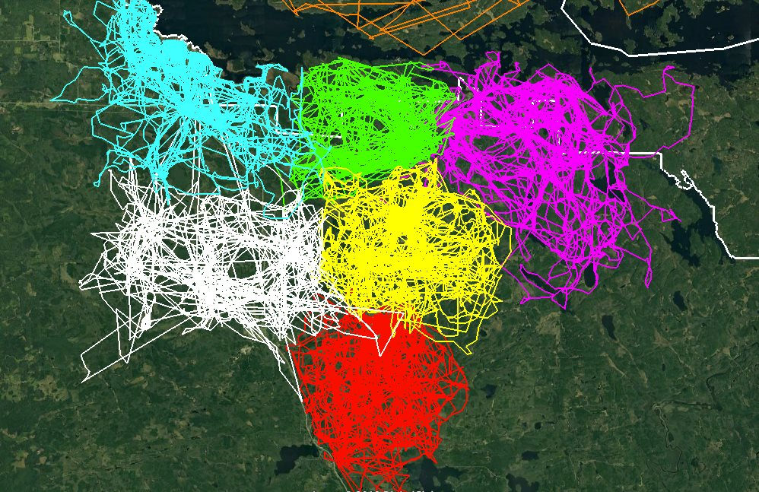
GPS Tracking Shows How Much Wolf Packs Avoid Each Other’s Range
Notes:
Instead of being like sheep, we should be more like wolves! “What?” You say.
Well, wolves have been recently shown to be masters at staying together. A study since 2015 in Minnesota has shown that wolf packs avoid each other’s range. Each wolf pack was tracked via GPS by colour and the results show that they all stay within their own domain—too bad Christians cannot stay with the good teaching that we have received. Instead, we tend to be like sheep who veer away.
So this leads to our question for today…
————————
GPS Tracking Shows How Much Wolf Packs Avoid Each Other’s Range
This image of GPS tracking of multiple wolves in six different packs around Voyageurs National Park was created in the framework of the Voyageurs Wolf Project. It is an excellent illustration of how much wolf packs in general avoid each other’s range.
In Voyageurs National Park a typical wolf pack territory is somewhere around 50-70 square miles but that can vary from year to year. So that’s about the size of the areas marked with the different colors. The white line marks the boundary of the national park.
As beautifully demonstrated by the animation, wolf packs generally avoid being around each other unless they are fighting for food that may be in short supply. When that occurs, they may engage in battles with other packs in order to continue have their claim on a given location as well as the food found within it.
Wolves may need to shift their territory due to human activity as well. When people clear out part of their natural habitat they may have to find a new route to get to their food sources. This can also create conflicts among the various wolf packs due to overstepping their bounds.
———————
https://earthlymission.com/gps-tracking-shows-how-much-wolf-packs-avoid-each-others-range/
Accessed 8 Jan 2020
About (Facebook page started in 2015)
The Voyageurs Wolf Project studies wolves and their prey (moose, deer, and beavers) during the summer in and around Voyageurs National Park, Minnesota.

Slide 8
Have you strayed?
Buying?
Porn?
Law v. Grace?
Imbalanced?
Notes:
How about you? Have you ever been deceived to follow teachings against the Bible?
• Have you fallen into the lie that buying something would make you happy? Did it? This is false teaching about material things.
• Have you ever seen porn? This teaches falsely about sex.
• Have you gotten out of balance too much towards grace or law?
• What about now? Are you out of balance in your understanding of God at all right now or do you completely understand God and fully obey him in every way?
So you are susceptible to false teaching, aren’t you?

Slide 9
How can you avoid straying into false teaching?
1 John
Notes:
• The first letter from the Apostle John tells us how to stop losing our way—wandering off, drifting—like sheep.

Slide 10
Theme
23
Obedience in Love Combats Early Gnosticism
1 John
Notes:
After Jesus left the earth and the church began, many different heresies proliferated very early. Gnosticism was the worst in the second century AD, but its beginnings are seen in letters like Colossians (AD 61) and John’s epistles (AD 85). The teaching of John’s first letter can be summed up as obedience in love combats Early Gnosticism. Early what?

Slide 11
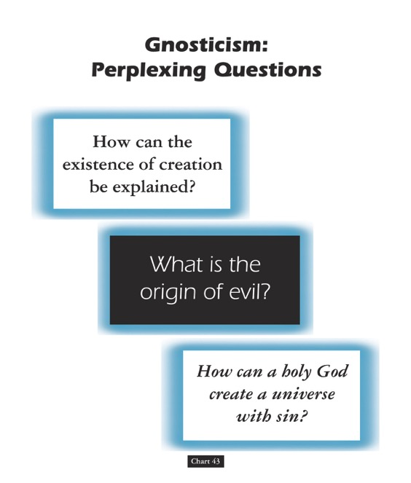
Gnosticism: Perplexing Questions
153a
How can the existence of creation be explained?
What is the origin of evil?
How can a holy God create a universe with sin?
Chart 43
John D. Hannah, Charts of Ancient & Medieval Church History (Grand Rapids: Zondervan, 2001)
Notes:
Dr John Hannah at Dallas Seminary sums it up well: "The Christian faith was opposed by numerous adversaries––threats from the state, ominous false religions, and heretics within its own borders. The most imposing religious threat came from Gnosticism, which was particularly dangerous because of its intellectual coherency. While Gnosticism seemed to provide answers to perplexing questions, it succeeded only in mixing a snippet of biblical truth with error.”
—Text from Hannah for this chart

Slide 12
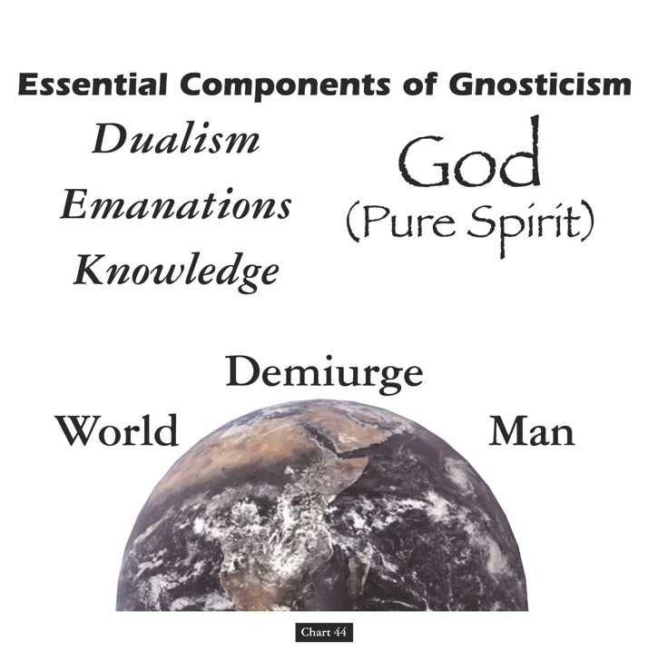
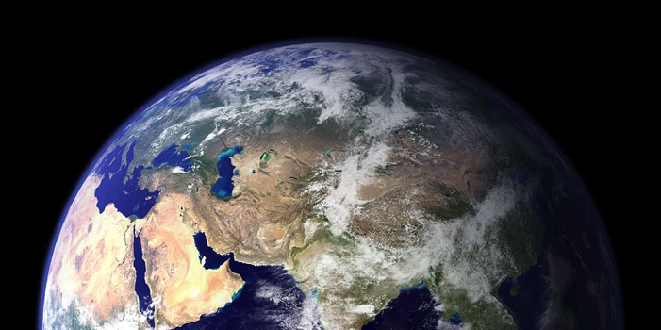
Essential Components of Gnosticism
153b
God
(Pure Spirit)
(1) Dualism
(2) Emanations
(3) Knowledge
Demiurge
World
Man
Chart 44
John D. Hannah, Charts of Ancient & Medieval Church History (Grand Rapids: Zondervan, 2001)
Notes:
"Gnosticism taught (1) that there is a radical dualism of the spiritual in opposition to the material (God, who is Spirit, is the supreme good, while matter is evil); (2) that God could not have created matter because it is contrary to his nature; rather, the world, which is material and evil, was created by the Demiurge (an emanation from God), and man is a material being with an entrapped spirit; and (3) that through a "secret knowledge," salvation becomes the life of escape from the material confines of the body."
—Text from Hannah for this chart

Slide 13

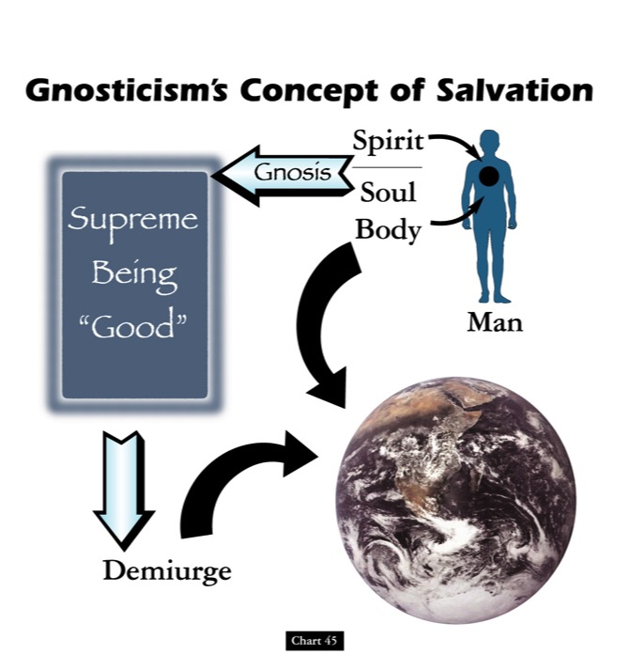

Gnosticism's Concept of Salvation
153c
Spirit
Supreme Being "Good"
Gnosis
Soul
Body
Man
Demiurge
Chart 45
John D. Hannah, Charts of Ancient & Medieval Church History (Grand Rapids: Zondervan, 2001)
Notes:
"Gnosticism's concept of salvation is as follows: God did not create the world, [1] but a lesser yet powerful being (the Demiurge) made this evil world and [2] mankind––though within man is a spark of good. [3] Salvation results from enlarging the capacity of that nature while minimizing the hold of materialism, [4] and it is accomplished by means of the secret teachings of Gnostic teachers. In resisting this teaching, Christian writers adopted a worldview that embraced the God of the Bible as the divine creator, affirmed the creation as good though marred by a subsequent devastation, and espoused the salvation of the body as well as the soul.”
—Text from Hannah for this chart [animation brackets mine]

Slide 14

Origin/Destination
291
A general letter sent from the aged John in Ephesus
Pergamum
Thyatira
Sardis
Smyrna
Philadelphia
Ephesus
Laodicea
Notes:
John lived the final decades of his life in the city of Ephesus in Asia Minor (modern-day Western Turkey), which was a key city where Gnosticism prevailed. From here he sent all three of his letters that we find in the NT.

Slide 15
NT Overview (General + Key Words)
38
124
39-41
"To the remotest part of the earth" (Acts 1:8)
Acts 9 13 14 15 16 18 21 27 28
Apr 48-
Sep 49
1
Galatia
Apr 50-
Sep 52
2
Aegean
Spr 53-
May 57
3
Asia
Feb 60-
Mar 62
1
Rome
Spr 62-
Fall 67
4
Spain
Aut 67-
Spr 68
2
Rome
Summer 35-
37
Damascus
Antioch
May 57-
Aug 59
Trials
Fall 49
The
Council
Spring 68
Expansion of Church
35 48 49 50 52 53 57 60 62 67 68 95
Matt
Kingdom
Luke
Sov 1
Acts
Sov 2
Mark
Disciple
John
Believe
Gal
Justify
1 Thess
Rapture
1 Cor
Eph
Unity
1 Tim
Order
2 Tim
Doctrine
Jude
Sanctify
Pretenders
James
Works
2 Thess
Tribulation
2 Cor
Col
Deity
Titus
Conduct
Heb
Super
1 John
Apostle
Love
Romans
Philem
1 Pet
Righteous
Forgive
Suffering
Gospels & Acts
Phil
Attitude
2 Pet
Knowledge
Pauline Epistles
1234
Journeys
General Epistles
Rome
Imprisonments
General Epistles + Key Words
Notes:
John’s epistles are among the last writings of the NT. John wrote around AD 85-90 after false teaching began to really invade the Church.

Slide 16

Argument
John's letter has at least five stated purposes:
1. to promote fellowship (1:3),
2. to produce joy (1:4),
3. to protect holiness (2:1),
4. to prevent heresy (2:26), and
5. to provide assurance of salvation (5:13)
This makes 1 John hard to sum up in one theme or purpose and difficult to outline, especially since the subjects overlap.
But the general theme of obedience, especially shown by loving others, sums up all of the above purposes.
These benefits are many, but the immediate benefit of obedience by love is its protection from early Gnosticism.
293
Notes:
This letter is a hard one to pin down its key emphasis as John repeats several themes.

Slide 17
1 John – Summary Chart
290
Obedience in Love Combats Early Gnosticism
Necessity of
Obedience
Characteristics of
Love
Benefits of
Obedience
Chapters 1–2
3:1–5:3
5:4-21
Humanity of Christ
Prerequisites to obedience
Hindrances to obedience
Don't sin
Don't hate believers
Compassion
Confidence before God
Obey apostolic teaching
Care for believers
Obey God's commands
Victory over the world
Assurance of salvation
Guidance in prayer
Freedom from sin
Fidelity to God
Ephesus to Asia Minor Churches
AD 85-95
Notes:
I have a chart on the back side of your notes as my best effort to sum up the entire letter. This is the last page of the digital notes on the website.

Slide 18
How can you avoid straying into false teaching?
1 John
Notes:
Let’s simplify that chart to answer the key question of the book: How can you avoid straying into false teaching? • The first letter from the Apostle John tells us • three key ways that we can stop losing our way—wandering off, drifting—like sheep.

Slide 19
HOW CAN YOU…
1 John
Obey
God’s commands
(1–2)
AVOID
STRAYING
…INTO FALSE TEACHING?
Notes:
What should you do to keep consistent amidst so many lies about God?
Don’t hold back in any area from doing what God wants you to do.

Slide 20
Slides on
1 John 1

Slide 21

I. Obey God’s commands
(1 John 1–2).
  Believe in Christ’s humanity for fellowship and joy (1:1-4).
Notes:
Jesus was truly man, despite what the Gnostics say—so when you grasp this, you’ll experience genuine relationships and contentment despite the circumstances.

Slide 22
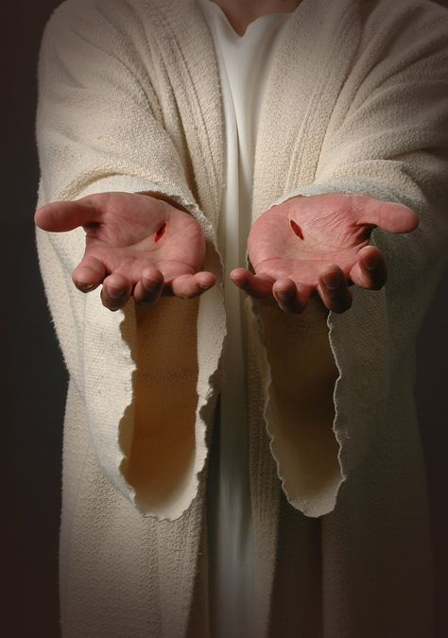
"We proclaim to you the one who existed from the beginning, whom we have heard and seen. We saw him with our own eyes and touched him with our own hands. He is the Word of life"
(1 John 1:1 NLT).

Slide 23
Gnostics Taught a "Secret Knowledge"
291
-292
Two Types Addressed in 1 John
Docetic Gnosticism
From dokeo, "to seem"
(Christ only seemed to be a man)
Matter is Evil
Depreciated Materialism
Denied Christ's Humanity
Touched Jesus (1:1)
Led to Asceticism
Immorality exalted
Cerinthian Gnosticism
From Cerinthus, founder in Asia
(Christ only seemed to be God)
Spirit is Good
Exalted Knowledge (gnosis)
Denied Christ's Deity
Water & Blood (5:6)
Led to Pride
Education exalted
Notes:
Many Gnostics denied Jesus was a real man. Others exalted the spirit so much that they denied his deity.

Slide 24
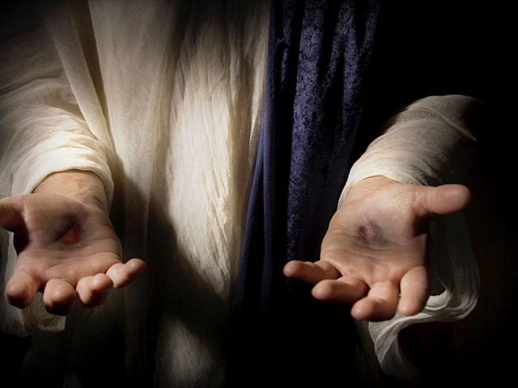
"This one who is life itself was revealed to us, and we have seen him. And now we testify and proclaim to you that he is the one who is eternal life. He was with the Father, and then he was revealed to us"
(1 John 1:2 NLT).

Slide 25
"We proclaim to you what we ourselves have actually seen and heard so that you may have fellowship with us. And our fellowship is with the Father and with his Son, Jesus Christ. ⁴ We are writing these things so that you may fully share our joy"
(1 John 1:3-4 NLT).

Slide 26
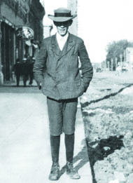
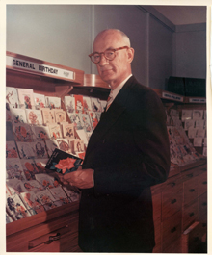
John taught that God showcased Jesus
291
-292
God did the same thing when He sent Jesus Christ into the world. That's when the Word of Life was moved from behind the counters, out of the drawers and placed in a display case for all the world to see, handle and admire.
"That which was from the beginning, which we have heard, which we have seen with our eyes, which we have looked at and our hands have touched––this we proclaim concerning the Word of life. The life appeared; we have seen it and testify to it, and we proclaim to you the eternal life, which was with the Father and has appeared to us" (1 John 1:1-2).
JC Hall
Illustration Exchange 26 June 2013
Notes:
The life of J.C. Hall, founder of Hallmark Cards, is a true rags-to-riches story. Born to poor parents, J.C. was quickly put to work, mostly in sales, to help keep himself and his family afloat. Along with his brothers, he began selling postcards in Norfolk, Nebraska. But the postcard business wasn't thriving there. So, with little else than a couple of shoe boxes of postcards, he moved to Missouri to start afresh. Full of innovative ideas, he moved on from postcards to greeting cards. When the store from which he operated burned down in 1915, he and his brothers invested in an engraving business and began printing their own cards.
• But it wasn't just the quality of the cards that burgeoned the business. It was Hall's groundbreaking idea to move the cards from behind the counters, where clerks would pick an "appropriate" card for the customer, out into display cases where customers could see them, handle them, and admire them.
By the time he died in 1982, Hall had turned two shoe boxes of postcards into a multi-billion dollar company.
Says the Hallmark corporate website, "J.C. Hall took greeting cards out of drawers in retail stores, and into displays that let shoppers see all their choices, dramatically changing the way cards were merchandised."
Application:
God did the same thing when He sent Jesus Christ into the world. That's when the Word of Life was moved from behind the counters, out of the drawers and placed in a display case for all the world to see, handle and admire.
"That which was from the beginning, which we have heard, which we have seen with our eyes, which we have looked at and our hands have touched--this we proclaim concerning the Word of life. The life appeared; we have seen it and testify to it, and we proclaim to you the eternal life, which was with the Father and has appeared to us" (1 John 1:1-2).
—Illustration Exchange website

Slide 27
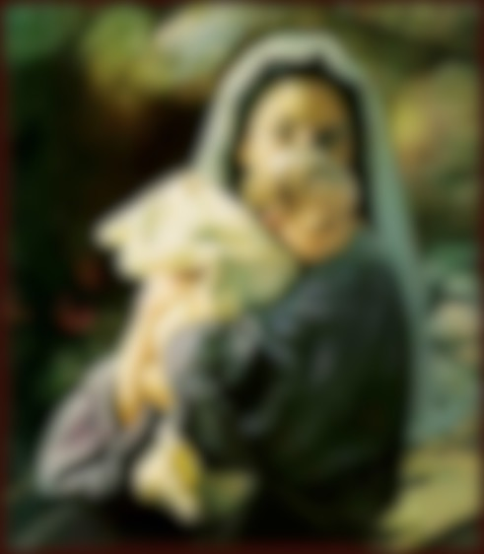
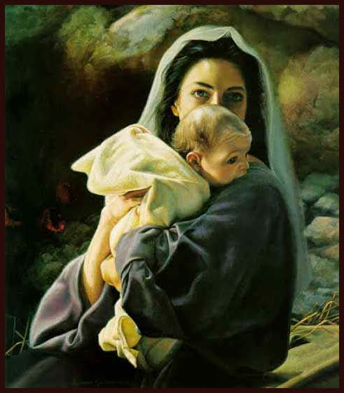
God Became Man

Slide 28
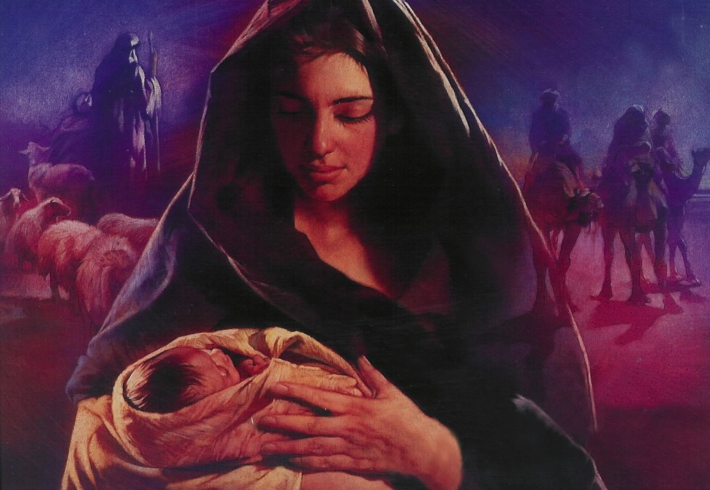
Hebrews 2:14 (NLT)
Because God’s children are human beings—made of flesh and blood—the Son also became flesh and blood.
For only as a human being could he die, and only by dying could he break the power of the devil, who had the power of death.
Notes:
Do you know why Jesus became a man? Why did God have to take on human flesh? Hebrews 2:14 tells us clearly…
We rightfully think of God becoming man at Christmas—a concept the theologians call the “incarnation.” This comes from the Latin in carne that literally means in flesh.
But how long will Jesus be a man “in flesh”? I’ll tell you—FOR ALWAYS!

Slide 29
I. Obey God’s commands
(1 John 1–2).
  Believe in Christ’s humanity for fellowship and joy (1:1-4).
  Depend on Jesus (1:5–2:14).
Notes:
Realize that you can’t live up to God’s standards in your own strength as you need Christ’s empowerment.

Slide 30

"This is the message we heard from Jesus and now declare to you:
God is light, and there is no darkness in him at all" (1 John 1:5 NLT).

Slide 31

"So we are lying if we say we have fellowship with God but go on living in spiritual darkness; we are not practicing the truth.
⁷ But if we are living in the light, as God is in the light, then we have fellowship with each other, and the blood of Jesus, his Son, cleanses us from all sin"
(1 John 1:6-7 NLT).

Slide 32
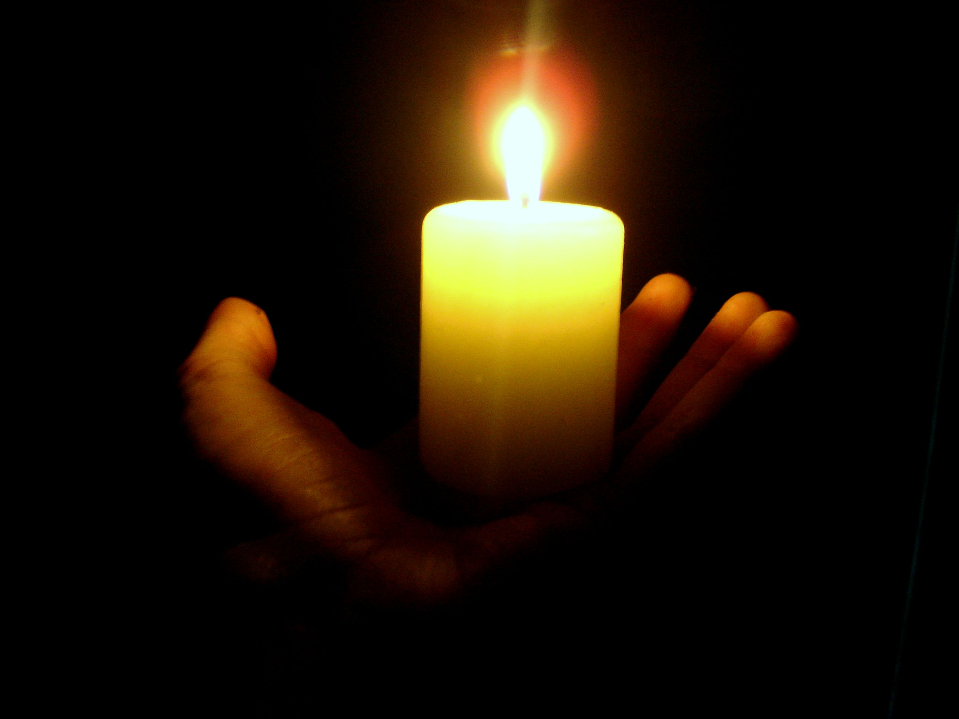
"If we claim we have no sin, we are only fooling ourselves and not living in the truth"
(1 John 1:8 NLT).
"If we claim we have not sinned, we are calling God a liar and showing that his word has no place in our hearts"
(1 John 1:10 NLT).

Slide 33

NT Forgiveness of Sin
121b
"If we confess our sins,
He is faithful and righteous to forgive us our sins and to cleanse us from all unrighteousness"
(1 John 1:9 NAU)
Pipe = Relationship with God (never changing)
Sin
Clog = Fellowship with God (hindered by sin)
Christ's Sacrifice = The Basis for Confession of Sin (sin is forgiven to restore fellowship but relationship has never been never threatened)
Notes:
Do we still have a relationship with God when we sin? Yes!
Sin does not hinder our relationship with God but our fellowship with Him.
—
OS-04-Num-30
OP-02-Lev-56
NS-23-1Jn-59

Slide 34
Slides on
1 John 2

Slide 35

"My dear children, I am writing this to you so that you will not sin. But if anyone does sin, we have an advocate who pleads our case before the Father. He is Jesus Christ, the one who is truly righteous" (1 John 2:1 NLT).

Slide 36
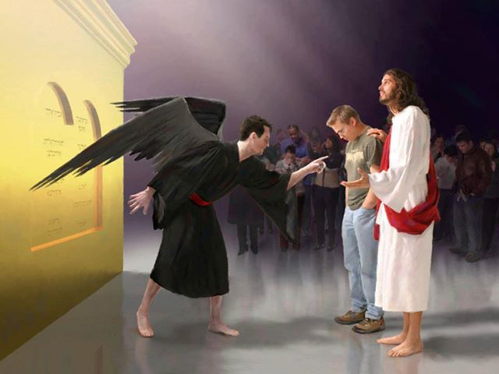
“Who then will condemn us? No one—for Christ Jesus died for us and was raised to life for us, and he is sitting in the place of honor at God’s right hand, pleading for us.”
Romans 8:34 (NLT)

Slide 37

"He himself is the sacrifice that atones for our sins—and not only our sins but the sins of all the world"
(1 John 2:2 NLT).

Slide 38
I. Obey God’s commands
(1 John 1–2).
  Believe in Christ’s humanity for fellowship and joy (1:1-4).
  Depend on Jesus (1:5–2:14).
  Avoid two hindrances to obedience to fight early Gnosticism (2:15-29).
Notes:
Both worldliness and deception will shift you over to the enemy’s camp.

Slide 39
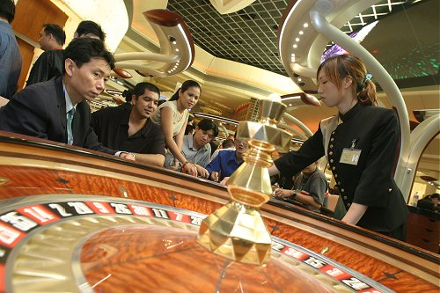
"Do not love the world" (1 John 2:15)
Notes:
One of those hindrances to obedience is worldliness—wanting to be more pleasing to the world than to God.

Slide 40
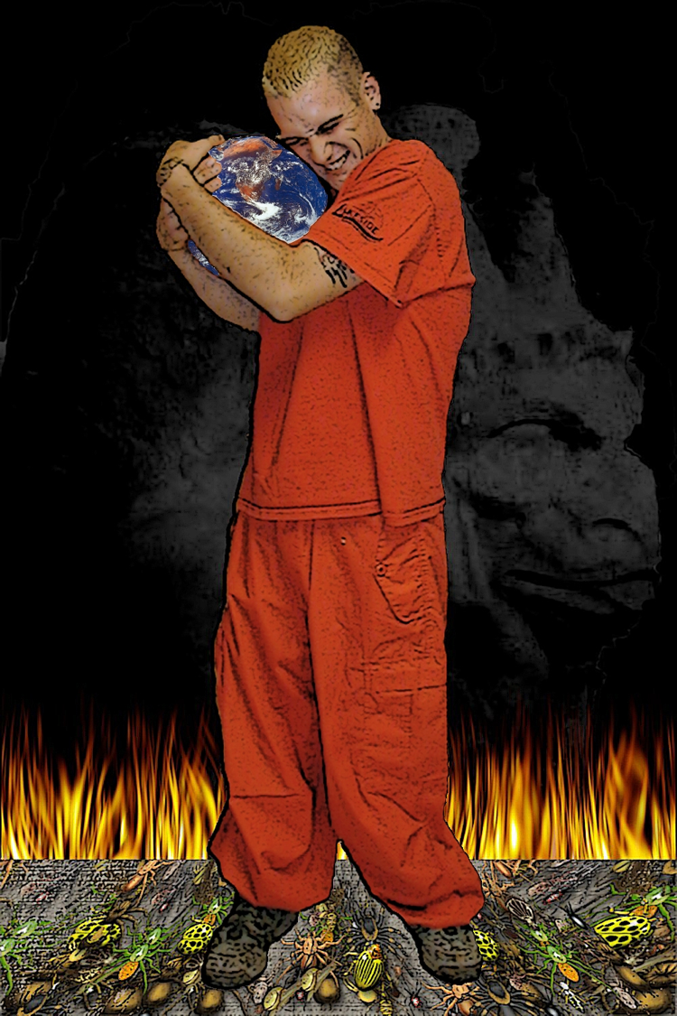
1 John 2:15 (NIV)
“Do not love the world or anything in the world. If anyone loves the world, the love of the Father is not in him.”
Notes:
John gives several reasons not to love the world.

Slide 41
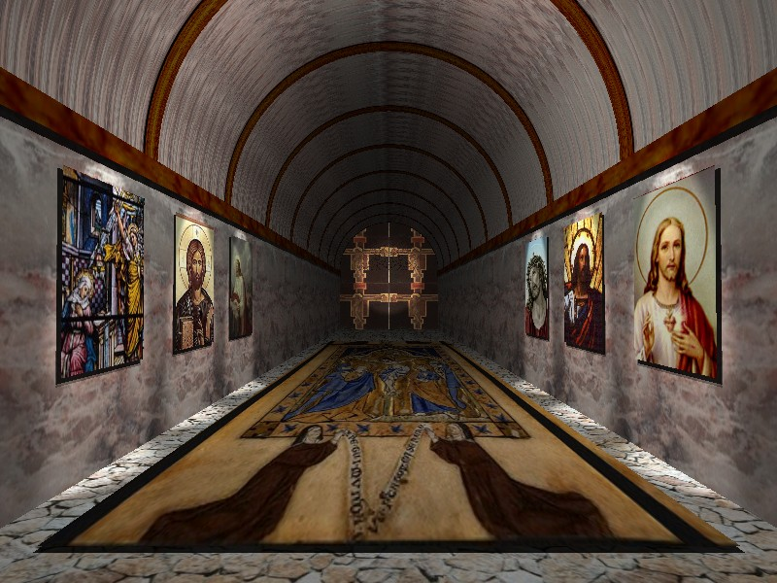
1 John 2:16-17 (NIV)
“For everything in the world–the cravings of sinful man, the lust of his eyes and the boasting of what he has and does–comes not from the Father but from the world. The world and its desires pass away, but the man who does the will of God lives forever.”
Notes:
One key reason not to love the is because the world is just temporary!

Slide 42
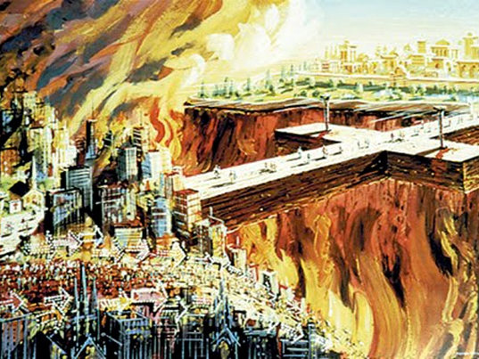
"…for the world and its desires are passing away"
(1 John 2:17a)
Notes:
Think of it—every building will be destroyed, every physical thing that we pour so much of our time and effort into will eventually be ruined or thrown away.

Slide 43

The Things of the World
Comparing Some Key Texts
296
World
(1 John 2:15-16)
Sources of Temptation
Eve
(Gen. 3)
Christ
(Matt. 4)
"Cravings of sinful man"
Ungodly bodily desires (sex outside marriage, gluttony, etc.)
"Good for food"
Stones to bread
"Lust of the eyes"
Greed, coveting
(10th commandment)
"Pleasing to the eye"
Possess all kingdoms
"Boasting of what he has
and does"
Pride & boasting of:
• occupation
• position
• worldly advantages
• etc.
"Desirable for gaining wisdom"
Acclaim by men
("throw yourself from the temple")
Notes:
The three things noted as “of the world” find parallels in the first temptation and Christ’s temptation.

Slide 44
Avoid two hindrances to obedience to fight early Gnosticism (2:15-29).
Worldliness
(2:15-17)
Deception
(2:18-29)
Notes:
How are we deceived? That which is against Jesus deceives us into thinking it is real and helpful.

Slide 45

"Dear children, the last hour is here. You have heard that the Antichrist is coming, and already many such antichrists have appeared. From this we know that the last hour has come. ¹⁹ These people left our churches, but they never really belonged with us; otherwise they would have stayed with us. When they left, it proved that they did not belong with us" (1 John 2:18-19 NLT).
Notes:
Does this mean that every person who leaves his church is antichrist? No, as some us sheep just go astray. He simply says that people opposing Jesus typically cannot last within the church. They eventually leave, especially if the church teaches the truth.

Slide 46
The Anointing of the Spirit
Xvi
H
"But you have an anointing from the Holy One, and all of you know the truth…²⁷As for you, the anointing you received from him remains in you, and you do not need anyone to teach you. But as his anointing teaches you about all things and as that anointing is real, not counterfeit—just as it has taught you, remain in him" (1 John 2:20, 27)
Notes:
NS-23-1 John-52
HS-04-Sealing, Indwelling-50

Slide 47
Ryrie on the Anointing
xvi
H
"The difference between the anointing and indwelling seems to lie in their distinct purposes. The indwelling brings the presence of God into the life of the believer. The anointing, as far as the believer is concerned, is that he might be taught (1 John 2:20, 27). Actually, this seems to be the only purpose specified in the believer's case.
Notes:
NS-23-1 John-53
HS-04-Sealing, Indwelling-51

Slide 48

Key Verse
290
John's Key Purpose in Writing
"I am writing these things to you about those who are trying to lead you astray… And now, dear children, continue in him, so that when he appears we may be confident and unashamed before him at his coming" (1 John 2:26, 28).

Slide 49
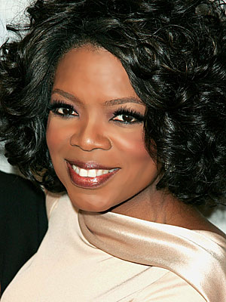
Oprah Winfrey’s Influence
22 million viewers each day!
Named most influential celebrity two years in a row (2012-2013)
Notes:
Most Gnostic-like false teachers would include Oprah Winfrey, consistently named one of the most influential women in the world.

Slide 50
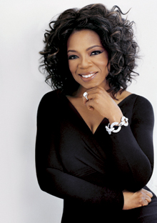
Oprah Leads Millions Astray
"All that is divine, my heart is open to you..."
"The universe is not interested in your struggles and your pain and your sorrow..."
"My heart is open to find the flow, the flow, the flow, the flow that is my life."
Notes:
Oprah says the type of things that are nebulous and thus difficult to refute.
__________
See 2:25 on the timer at https://www.youtube.com/watch?v=oq6ejJqpOTs
See also http://www.jesus-is-savior.com/Wolves/oprah-fool.htm where she dies Christ as the only way to God.

Slide 51
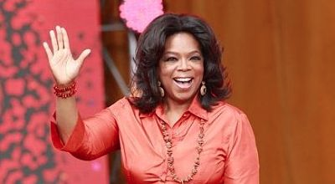
Oprah Leads Millions Astray
“I am not talking about religion. I am a Christian. That is my faith. I'm not asking you to be a Christian. If you want to be one I can show you how. But it is not required. I have respect for all faiths. All faiths. But what I'm talking about is not faith or religion. I'm talking about spirituality,” Winfrey said.
Notes:
Many false teachers claim to be Christians and then redefine it. The real issue is Jesus—the “elephant in the room” whom they rarely discuss—certainly not his death and resurrection and return!
________
Oprah Winfrey: ‘I Am a Christian’
2:20PM EDT 4/26/2012 Jennifer LeClaire
http://www.charismanews.com/us/33290-oprah-winfrey-i-am-a-christian

Slide 52
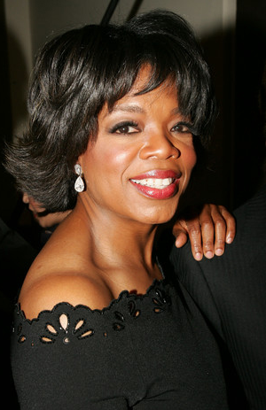
Oprah Leads Millions Astray
One commented on her…
“Take a few moments and imagine a religion where Jesus did not come to die on the cross, where there is no heaven, no hell, no sin, no salvation, no doctrine, where all spiritual paths in the world are equally valid and where ‘god’ is in you and in everything else you see.
That is the religion of Oprah Winfrey.
It is also the New Age ‘one world religion’ that many other spiritual gurus throughout the world have been trying to bring to fruition.”
Notes:
Oprah Winfrey: Jesus Did Not Come To Die On The Cross
http://www.curezone.com/forums/am.asp?i=1862458

Slide 53
HOW CAN YOU…
1 John
Obey
God’s commands
(1–2)
Love
others
(3:1–5:3 )
AVOID
STRAYING
…INTO FALSE TEACHING?
Notes:
What should you do to keep consistent amidst so many lies about God?

Slide 54
Slides on
1 John 3

Slide 55

II. Love others (3:1–5:3).
  Don’t sin (3:1-10)
Notes:
RESTATE

Slide 56
How much can a believer sin
(1 John 3:4)?
NLT (cf. NIV)
"Everyone who sins is breaking God’s law, for all sin is contrary to the law of God.”
Absolute
NAU (cf. NET)
"Everyone who practices sin also practices lawlessness; and sin is lawlessness.”
Habitual
Both translations are possible in the Greek text.
However, wouldn't it be lawless to sin even once?

Slide 57
How much can a believer sin
(1 John 3:6)?
NLT (cf. NIV)
" Anyone who continues to live in him will not sin. But anyone who keeps on sinning does not know him or understand who he is.”
Habitual
NAU (cf. NET)
"No one who abides in Him sins; no one who sins has seen Him or knows Him.”
Absolute

Slide 58
Each of the preceding four translations are inconsistent in rendering verses 4 and 6.
But NLT, NAU, and NET all give the habitual sense to verse 6—all but the NIV, that reads, “He who does what is sinful is of the devil…”
BOTTOM LINE:
We sin when we follow Satan rather than God!

Slide 59
II. Love others (3:1–5:3).
  Don’t sin (3:1-10)
  Don’t hate believers (3:11-15)
Notes:
RESTATE

Slide 60
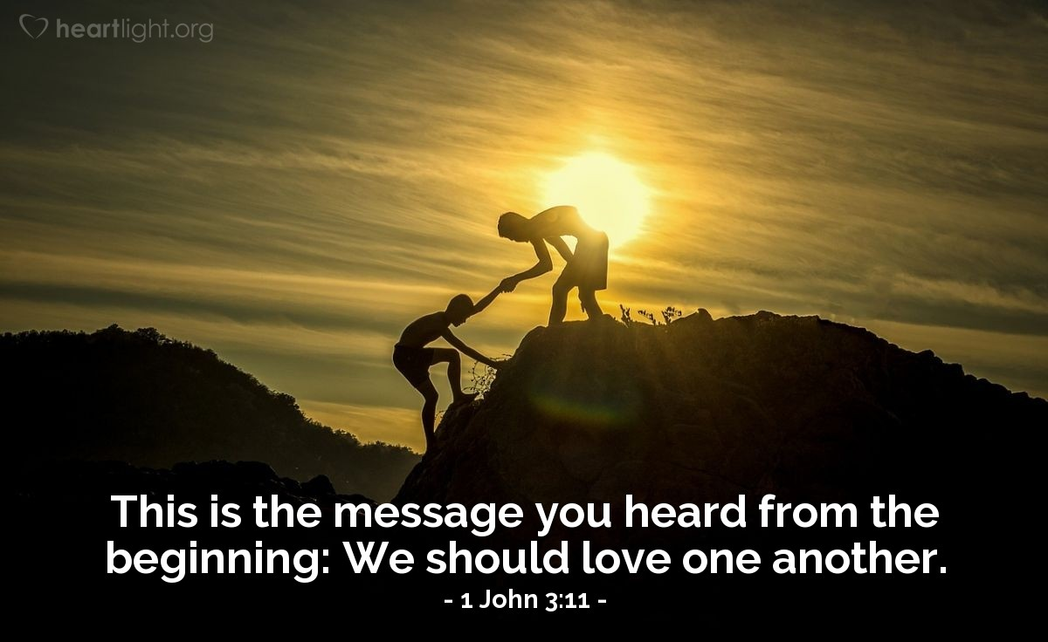
"This is the message you have heard from the beginning: We should love one another"
(1 John 3:11 NLT).

Slide 61
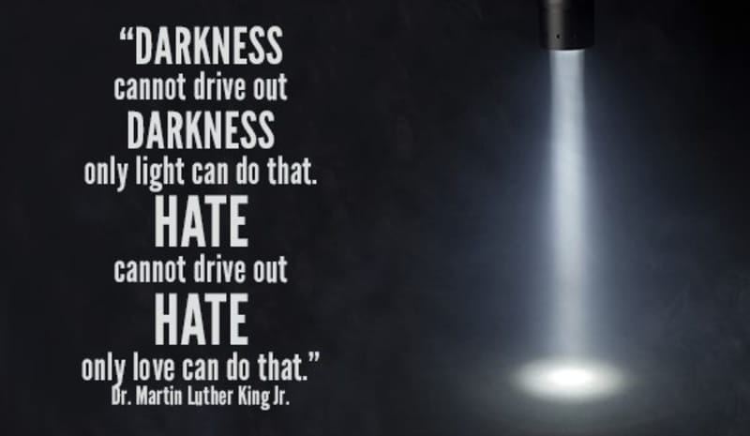
Hatred of people is from Satan.

Slide 62
II. Love others (3:1–5:3).
  Don’t sin (3:1-10)
  Don’t hate believers (3:11-15)
  Show compassion (3:16-20)
Notes:
RESTATE

Slide 63
"We know what real love is because Jesus gave up his life for us. So we also ought to give up our lives for our brothers and sisters. ¹⁷ If someone has enough money to live well and sees a brother or sister in need but shows no compassion—how can God’s love be in that person?" (1 John 3:16-17 NLT).

Slide 64
"Dear children, let’s not merely say that we love each other; let us show the truth by our actions. ¹⁹ Our actions will show that we belong to the truth, so we will be confident when we stand before God.
²⁰ Even if we feel guilty, God is greater than our feelings, and he knows everything" (1 John 3:18-20 NLT).

Slide 65
II. Love others (3:1–5:3).
  Don’t sin (3:1-10)
  Don’t hate believers (3:11-15)
  Show compassion (3:16-20)
  Be confident before God (3:21-24)
Notes:
RESTATE

Slide 66

"Dear friends, if we don’t feel guilty, we can come to God with bold confidence"
(1 John 3:21 NLT).

Slide 67
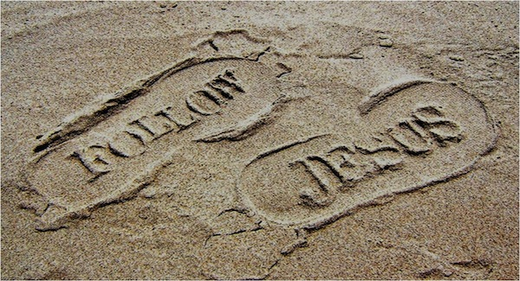
And we will receive from him whatever we ask because we obey him and do the things that please him"
(1 John 3:22 NLT)."

Slide 68
"And this is his commandment: We must believe in the name of his Son, Jesus Christ, and love one another, just as he commanded us. ²⁴ Those who obey God’s commandments remain in fellowship with him, and he with them. And we know he lives in us because the Spirit he gave us lives in us"
(1 John 3:23-24 NLT).

Slide 69
Slides on
1 John 4

Slide 70
II. Love others (3:1–5:3).
  Don’t sin (3:1-10)
  Don’t hate believers (3:11-15)
  Show compassion (3:16-20)
  Be confident before God (3:21-24)
  Obey apostolic teaching (4:1-6)
Notes:
RESTATE

Slide 71

Test the spirits (4:1)

Slide 72
"Dear friends, do not believe everyone who claims to speak by the Spirit. You must test them to see if the spirit they have comes from God. For there are many false prophets in the world. ²This is how we know if they have the Spirit of God: If a person claiming to be a prophet acknowledges that Jesus Christ came in a real body, that person has the Spirit of God"
(1 John 4:1-2 NLT).

Slide 73
"But if someone claims to be a prophet and does not acknowledge the truth about Jesus, that person is not from God. Such a person has the spirit of the Antichrist, which you heard is coming into the world and indeed is already here"
(1 John 4:3 NLT).

Slide 74
"But you belong to God, my dear children. You have already won a victory over those people, because the Spirit who lives in you is greater than the spirit who lives in the world.
⁵ Those people belong to this world, so they speak from the world’s viewpoint, and the world listens to them"
(1 John 4:4-5 NLT).

Slide 75
"But we belong to God, and those who know God listen to us. If they do not belong to God, they do not listen to us. That is how we know if someone has the Spirit of truth or the spirit of deception"
(1 John 4:6 NLT).

Slide 76
II. Love others (3:1–5:3).
  Don’t sin (3:1-10)
  Don’t hate believers (3:11-15)
  Show compassion (3:16-20)
  Be confident before God (3:21-24)
  Obey apostolic teaching (4:1-6)
  Care for believers (4:7-21)
Notes:
RESTATE

Slide 77
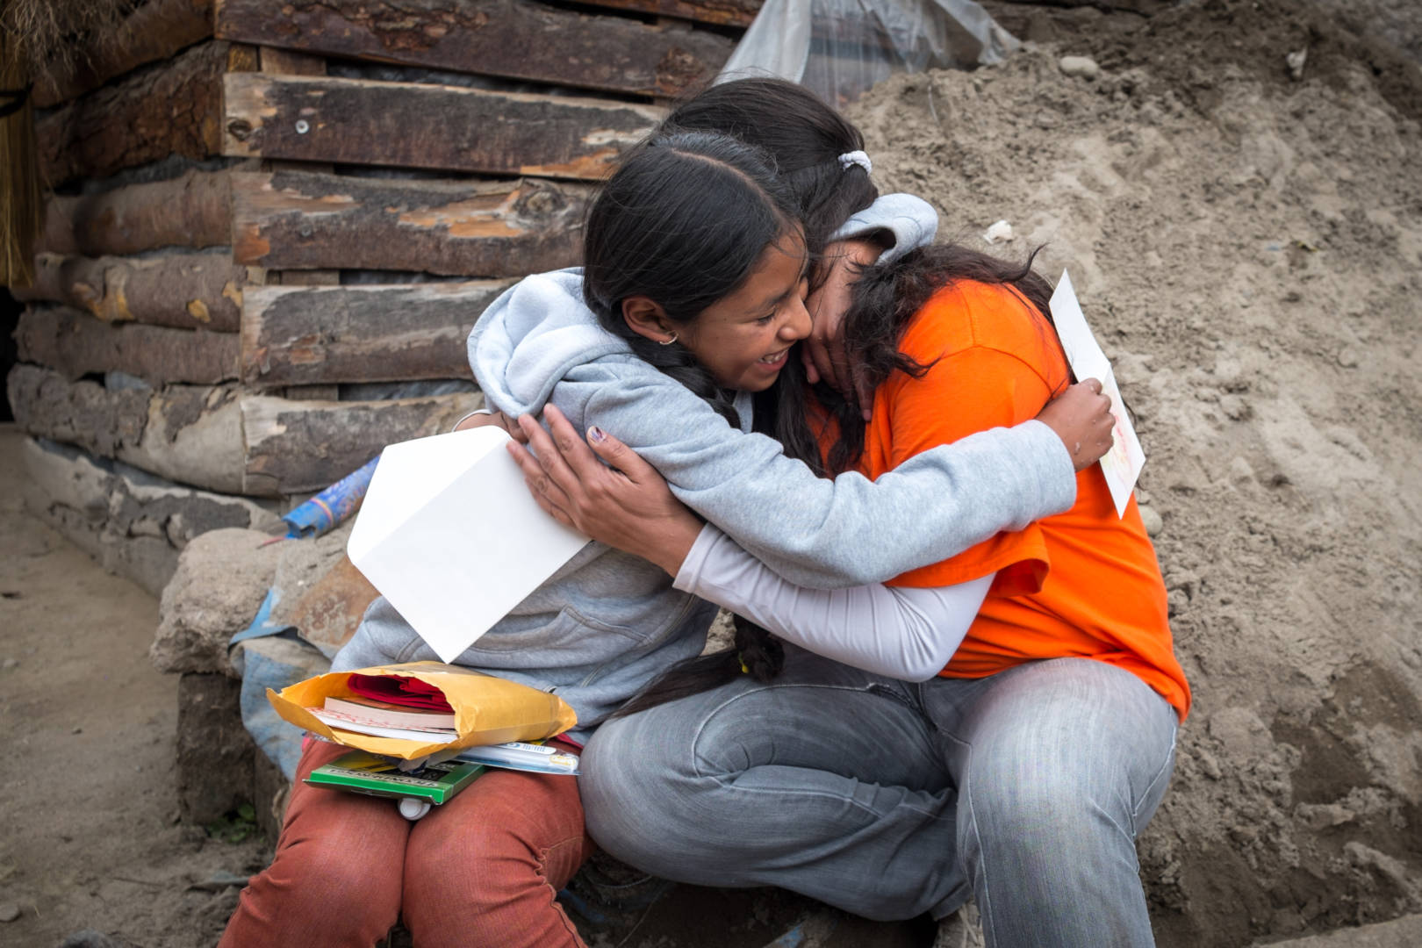
"Dear friends, let us continue to love one another, for love comes from God. Anyone who loves is a child of God and knows God. ⁸ But anyone who does not love does not know God, for God is love" (1 John 4:7-8 NLT).

Slide 78
Slides on
1 John 5

Slide 79
II. Love others (3:1–5:3).
  Don’t sin (3:1-10)
  Don’t hate believers (3:11-15)
  Show compassion (3:16-20)
  Be confident before God (3:21-24)
  Obey apostolic teaching (4:1-6)
  Care for believers (4:7-21)
  Obey God’s commands (5:1-3)
Notes:
RESTATE

Slide 80

"Everyone who believes that Jesus is the Christ has become a child of God. And everyone who loves the Father loves his children, too. ² We know we love God’s children if we love God and obey his commandments. ³ Loving God means keeping his commandments, and his commandments are not burdensome"
(1 John 5:1-3 NLT).

Slide 81
HOW CAN YOU…
1 John
Obey
God’s commands
(1–2)
Love
others
(3:1–5:3 )
AVOID
STRAYING
Realize that obedience produces
what you really need
(5:4-21)
…INTO FALSE TEACHING?
Notes:
What should you do to keep consistent amidst so many lies about God?

Slide 82
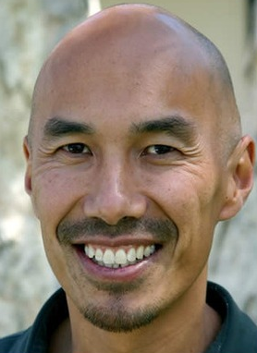
— Francis Chan —
The Bible says that when we obey God’s commands, we benefit. I think we naturally assume that if we look out for our own interests and concerns, we will be happy. But people who sacrifice for others will tell you that seasons of giving are the most rewarding of their lives.

Slide 83

Benefits of Obedience:
III. Realize that obedience produces what you really need (5:4-21).
Victory over the world system (5:4-5)
Notes:
Rather than living a defeated life, you will conquer the world—literally!

Slide 84
"For every child of God defeats this evil world, and we achieve this victory through our faith. ⁵ And who can win this battle against the world? Only those who believe that Jesus is the Son of God"
(1 John 5:4-5 NLT).

Slide 85
Benefits of Obedience:
III. Realize that obedience produces what you really need (5:4-21).
Victory over the world system (5:4-5)
Assurance of salvation (5:6-13)
Notes:
Rather than doubt your state (now and forever), you will know that you have eternal life!

Slide 86

God’s Gift (1 John 5:12-13)
"And this is what God has testified:
He has given us eternal life, and this life is in his Son. ¹²Whoever has the Son has life; whoever does not have God’s Son does not have life. ¹³I have written this to you who believe in the name of the Son of God, so that you may know you have eternal life."
Notes:
Do you have the Son? Then what else do you have? Life! Eternal life!
Have you believed in the Son? Then you can know that you have eternal life—not wish for eternal life, not hope for eternal life, not work for eternal life, but know that you have eternal life.
So the question this Christmas is whether you have the Son. He invites you into his manger, as it were, to trust him so that you can be with him “for always.”

Slide 87
Benefits of Obedience:
III. Realize that obedience produces what you really need (5:4-21).
Victory over the world system (5:4-5)
Assurance of salvation (5:6-13)
Guidance in prayer (5:14-17)
Notes:
Rather than live aimlessly, you will have God lead you as you talk to him.

Slide 88
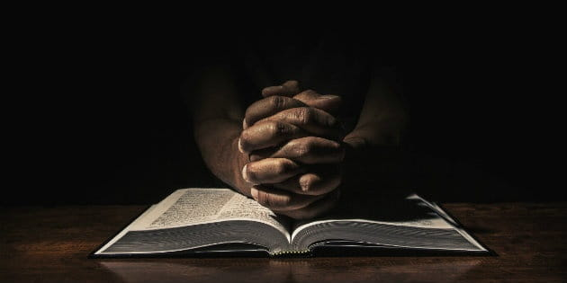
"And we are confident that he hears us whenever we ask for anything that pleases him. ¹⁵ And since we know he hears us when we make our requests, we also know that he will give us what we ask for" (1 John 5:14-15 NLT).

Slide 89
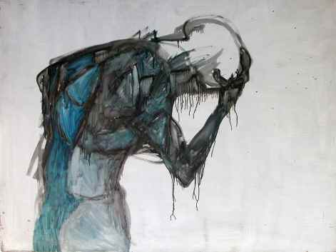
Some sin leads to premature death (1 John 5:16-17 NIV)
“If anyone sees his brother commit a sin that does not lead to death, he should pray and God will give him life. I refer to those whose sin does not lead to death. There is a sin that leads to death. I am not saying that he should pray about that. ¹⁷All wrongdoing is sin, and there is sin that does not lead to death.”

Slide 90
Benefits of Obedience:
III. Realize that obedience produces what you really need (5:4-21).
Victory over the world system (5:4-5)
Assurance of salvation (5:6-13)
Guidance in prayer (5:14-17)
Freedom from habitual sin (5:18-20)
Notes:
Rather than be a slave to your passions, you will be liberated.

Slide 91
How much can a believer sin
(1 John 5:18)?
NLT (cf. NIV)
" We know that God’s children do not make a practice of sinning, for God’s Son holds them securely, and the evil one cannot touch them.”
Habitual
NAU (cf. NET)
"We know that no one who is born of God sins; but He who was born of God keeps him, and the evil one does not touch him.”
Absolute

Slide 92
Benefits of Obedience:
III. Realize that obedience produces what you really need (5:4-21).
Victory over the world system (5:4-5)
Assurance of salvation (5:6-13)
Guidance in prayer (5:14-17)
Freedom from habitual sin (5:18-20)
Fidelity to God by avoiding idolatry (5:21)
Notes:
Rather than other things having a grip on you, you’ll have trust God like a little child.

Slide 93


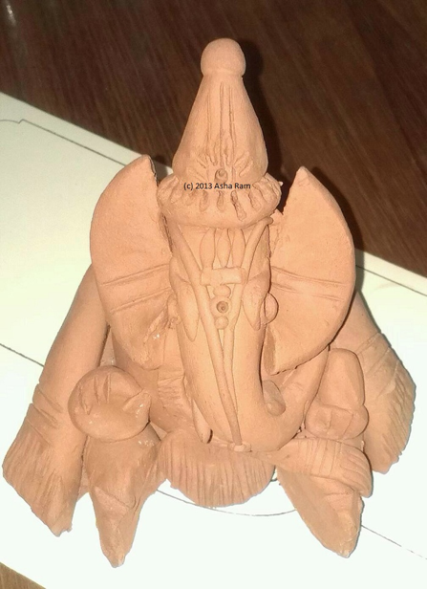

1 John 5:21 (NIV)
"Keep yourself from idols"

Slide 94

"Dear children, keep away from anything that might take God’s place in your hearts" (1 John 5:21 NLT).

Slide 95
HOW CAN YOU…
1 John
Obey
God’s commands
(1–2)
Love
others
(3:1–5:3 )
AVOID
STRAYING
Realize that obedience produces
what you really need
(5:4-21)
…INTO FALSE TEACHING?
Notes:
What should you do to keep consistent amidst so many lies about God?

Slide 96

Main Idea of the Letter
Obey God and love others and you’ll have what you really need instead of false teaching.
1 John
Notes:
We stay on track spir
itually and benefit greatly by obeying God and loving each other (commands restated).

Slide 97
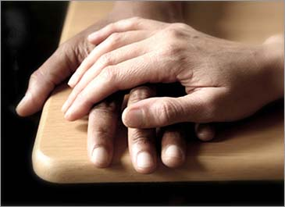
Application
290
How can you show love to another believer so that heresy might be thwarted?
Whom do you know that needs to see Christian love shown in order to turn from false teaching?

Slide 98
Black

Slide 99


NT Preaching • BibleStudyDownloads.org
Get this presentation and script for free!

